Slide 1
New Page : Package Page
Create new folder as packages
In packages folder create index.html
Copy the entire code from our main index.html into packages index.html file.
Delete all 3 section from main tag from packages index.html file.
Change the file path in menu

Slide 2
New Page : Package Page
Setting up CSS for package page
Package page shares the header and footer styles with main.css
Create new css file next to main.css as shared.css
Cut the header , footer , button and navigation code and paste in shared.css
Import shared.css in main index.html file and in package index.html file

Slide 3
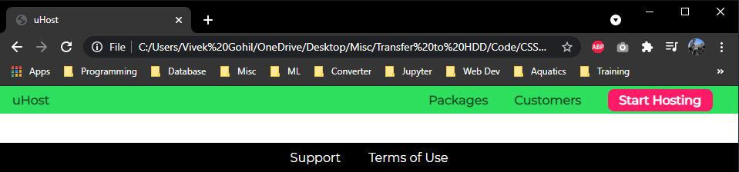
New Page : Package Page

Slide 4
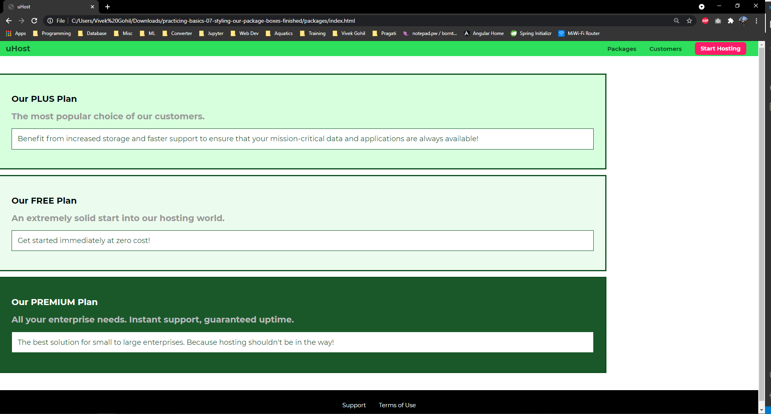
Decorate Package page : Task
Add shared code in main tag and make it look like below image.

Slide 5
Decorate Package page : Solution
main{
padding-top: 16px;
} .package{
border: 4px solid #0e4f1f;
margin: 16px 0px;
width: 80%;
border-left: none;
}
.package a {
text-decoration: none;
color: inherit;
display: block;
padding: 32px;
}
.package__subtitle{
color: #979797;
}
.package__info{
border: 1px solid #0e4f1f;
padding: 16px;
font-size: 20px;
color: #0e4f1f;
background: white;
} #plus{
background: rgba(213, 255, 220, 0.95);
}
#free{
background: rgba(235, 252, 237, 0.95);
}
#premium{
background: rgba(14, 79, 31, 0.95);
}
#premium .package__title{
color: white;
} #premium .package__subtitle{
color: #bbb;
}

Slide 6
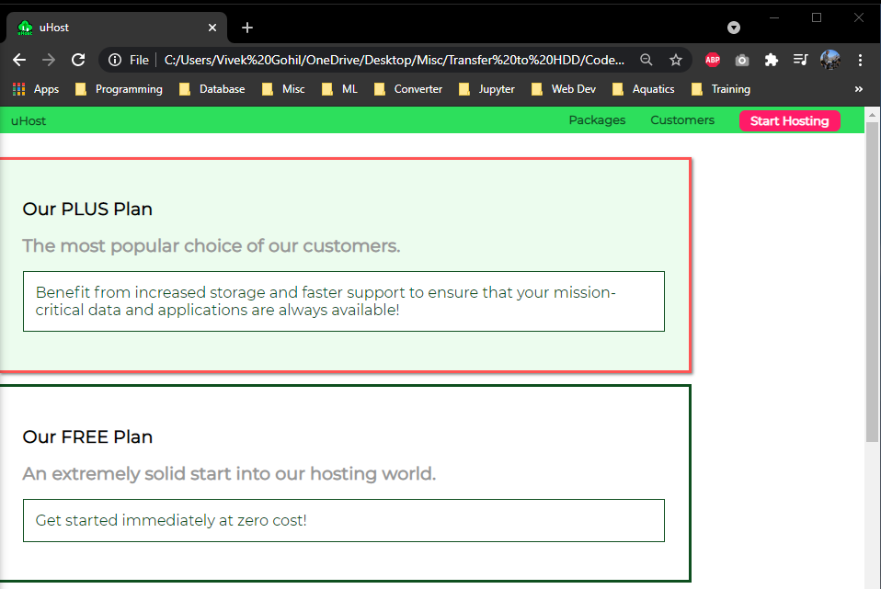
Decorate Package page
Apply hover over effect for all package
.package:hover,
.package:active{
box-shadow: 2px 2px 4px rgba(0,0,0,0.5);
border-color: #ff5454;
}

Slide 7
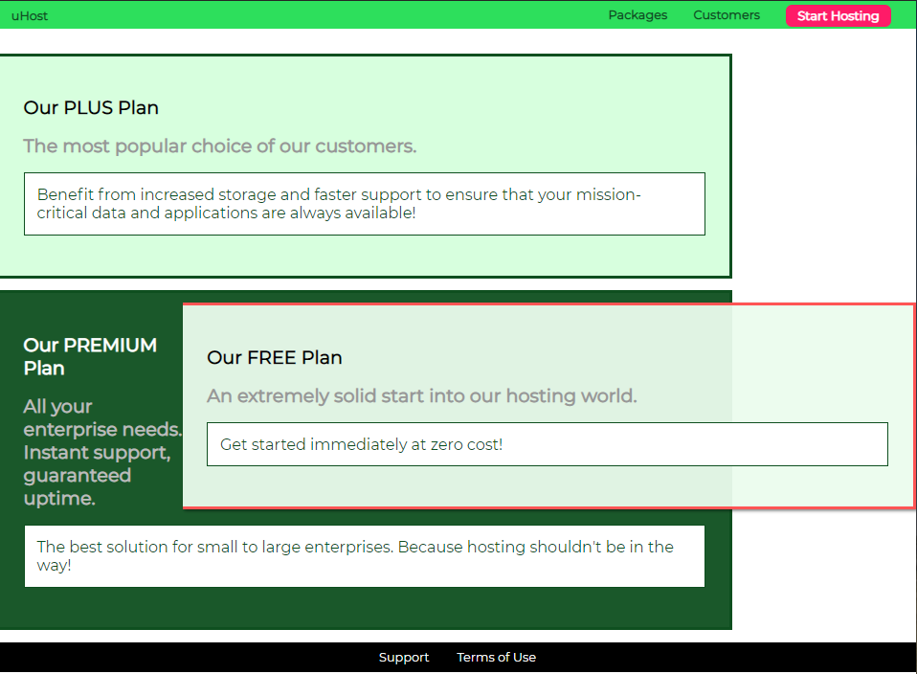
Decorate Package page
Understand and apply float effect
Apply the float : right property to the free package.

Slide 8
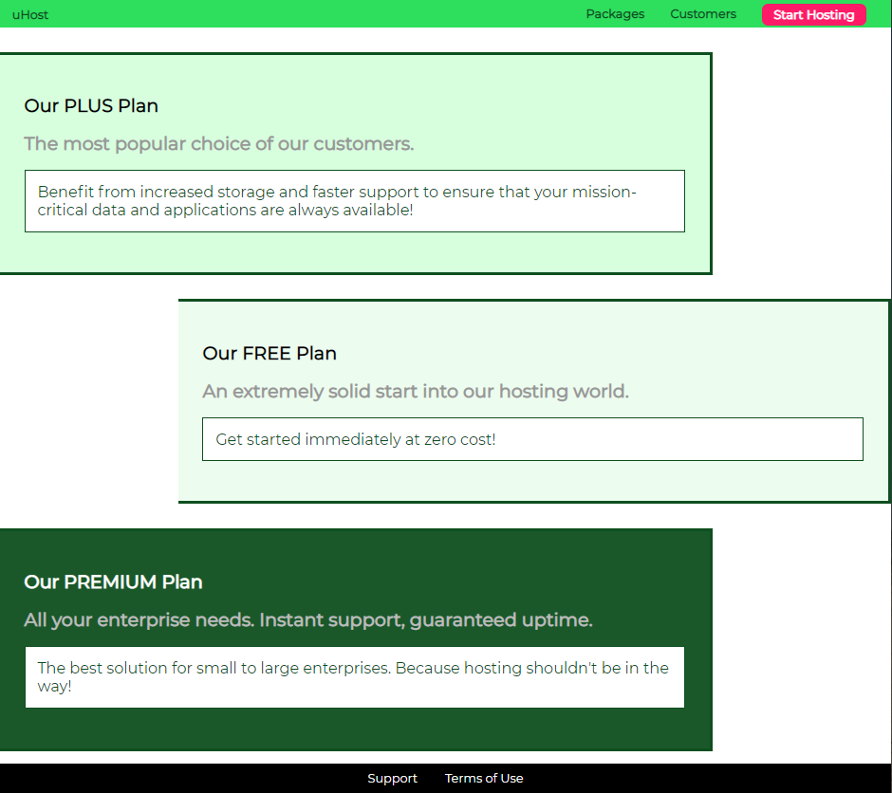
Decorate Package page
Add new div with class = clearfix below the free plan to avoid the free flow of the element.
In packages.css file add the rule as clear:both
<div class="clearfix"></div>
.clearfix{
clear: both;
}

Slide 9

Decorate Package page
Fix the style
Apply border from left
Change the text align
#free{
background: rgba(235, 252, 237, 0.95);
float: right;
border-right: none;
border-left: 4px solid #0e4f1f;
text-align: right;
}

Slide 10
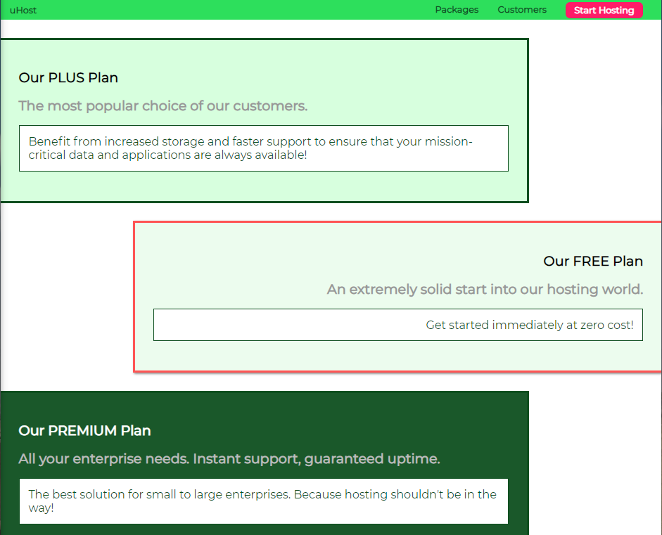
Decorate Package page : task
Fix the hover over effect
#free:hover,
#free:active{
border-left: 4px solid #0e4f1f;
}
.package:hover,
.package:active{
box-shadow: 2px 2px 4px rgba(0,0,0,0.5);
border-color: #ff5454 !important;
}

Slide 11
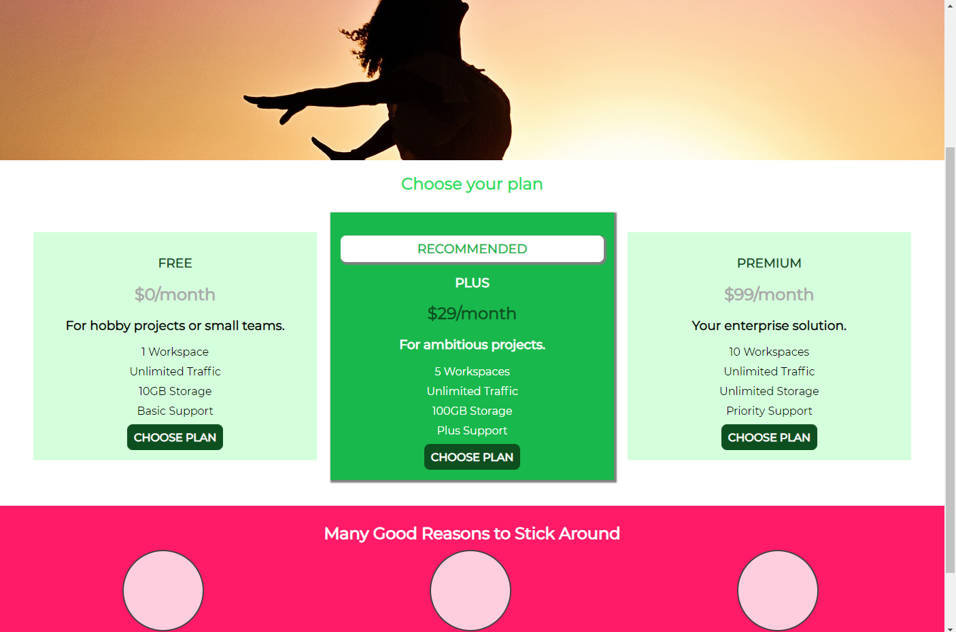
Giving Final Touches
Center align the plans on home page
Assing plan__list class to the div
.plan__list
{
text-align: center;
margin: auto;
}

Slide 12
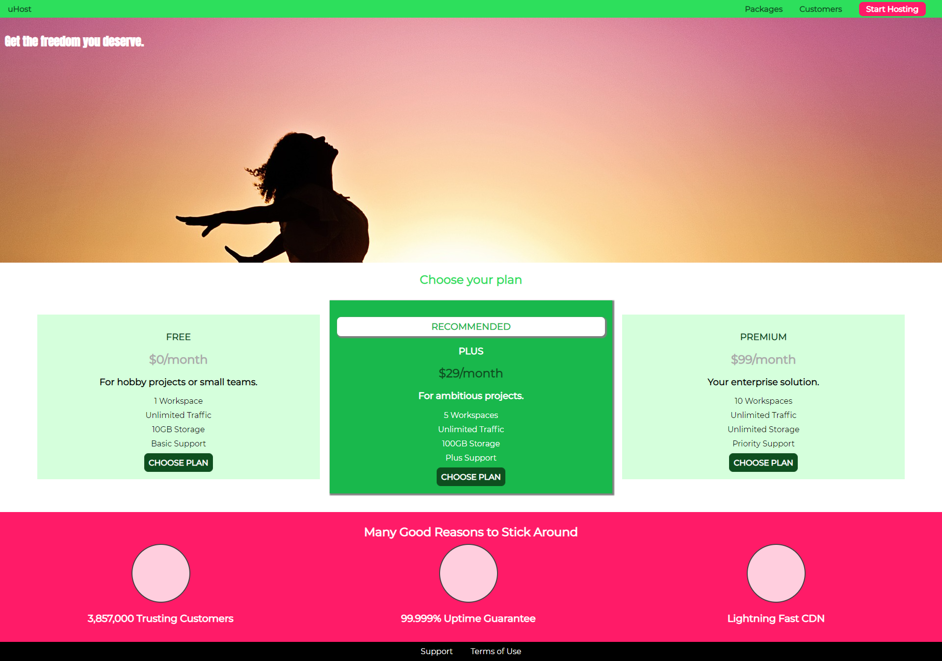
Final Page 1

Slide 13
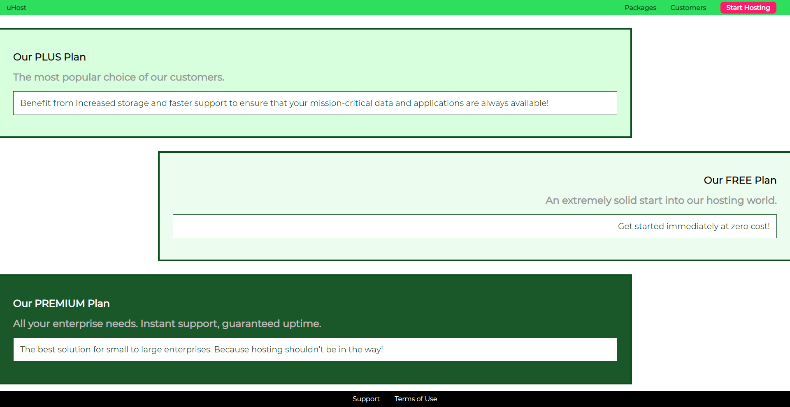
Final Page 2

Slide 14
Positioning
How to change the position of elements

Slide 15
Content
Understanding the “Position” property
Fixed Navigation bar with “fixd”
Positioning Element with “z-index”
Using “absolute” and “relative” stand alone and combined
“sticky” positioning
The “Stacking Context”

Slide 16
What Positioning will improve our website - Goal
Home Page
Add Fix navigation bar
Position the text on image properly
Packages Page
Add Background Image
Improve the design the Plus Plan – Add a badge

Slide 17
What Positioning will improve our website - Goal

Slide 18
Understanding Positioning
<html>
Position:
<body>
static
Default
div
absolute
relative
div
Document Flow
fixed
div
sticky

Slide 19
Understanding Positioning
top
<html>
<body>
div
div
viewport
left
div
right
<html>
div
<body>
bottom
div
<..>
Document Flow
Positioning Context

Slide 20
Positioning Example – Startup project
<!DOCTYPE html>
<html lang="en">
<head>
<meta charset="UTF-8">
<meta http-equiv="X-UA-Compatible" content="ie=edge">
<link rel="stylesheet" href="main.css">
<title>Position</title>
</head>
<body>
<div class="parent">
<div class="child-1">Navigation Bar</div>
<div class="child-2">Background Image</div>
<div class="child-3">Features</div>
</div>
</body>
</html>

Slide 21
Positioning Example – Startup project
html {
background: #b3b3b3;
padding: 15px;
border: 5px solid white;
margin: 15px;
height: 2000px;
}
body {
background: #fa923f;
padding: 20px;
border: 5px solid black;
margin: 0;
}
.parent {
background: white;
padding: 20px;
border: 5px solid black;
margin: 0;
}
.parent div {
background: rgb(105, 105, 109);
color: white;
padding: 10px;
border: 5px solid black;
margin: 10px;
}

Slide 22
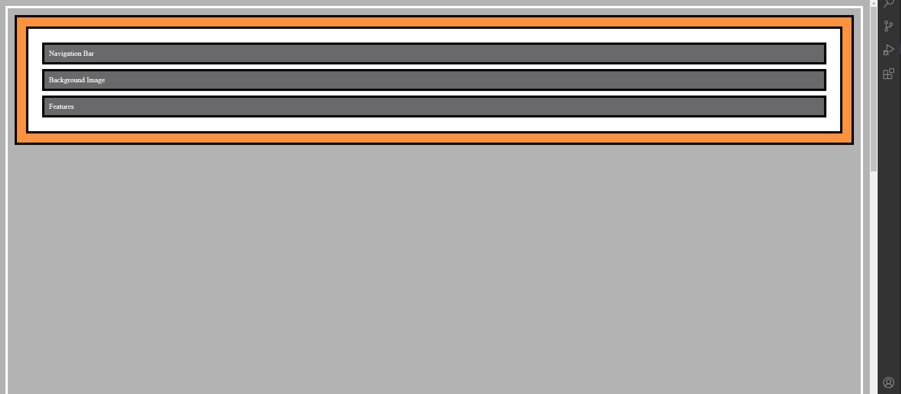
Positioning Example – Startup project

Slide 23
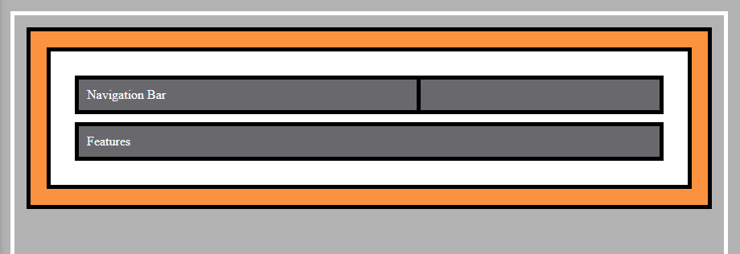
Applying positioning property : fixed
Change the position property of first dive (child-1) to fixed.
Change the width of child-1
.parent .child-1
{
position: fixed;
width: 400px;
}

Slide 24
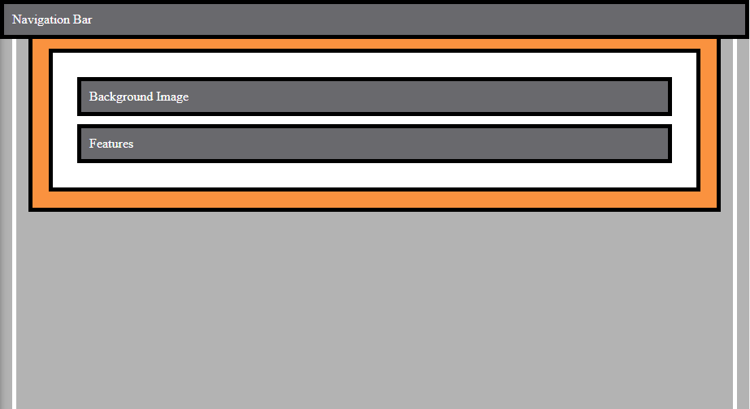
Applying positioning property : top, bottom etc
Using position property make div to be appear like a navigation bar.
.parent .child-1
{
position: fixed;
width: 400px;
top: 0px;
left:0px;
margin: 0;
width :100%;
box-sizing: border-box;
}

Slide 25
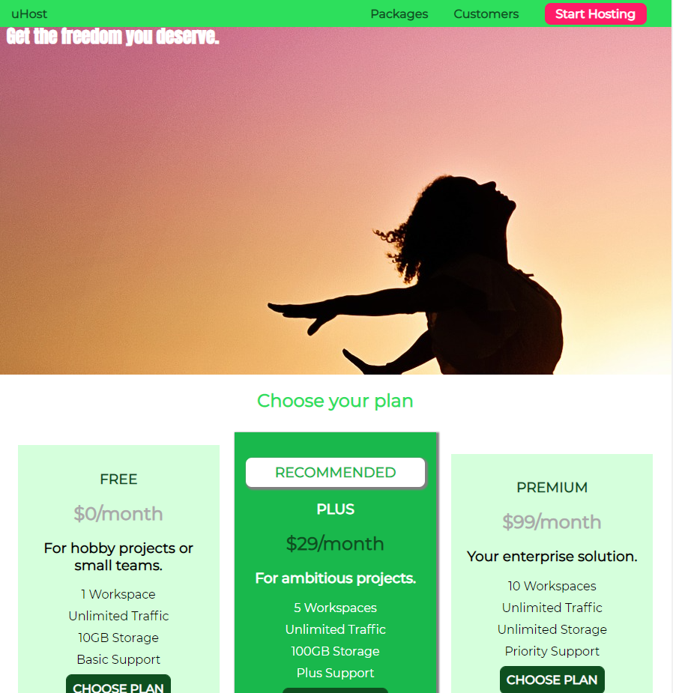
Create Fixed Navigation Bar In Website
.main-header {
width: 100%;
background: #2ddf5c;
padding: 8px 16px;
position: fixed;
}

Slide 26

Positioning
Add a Background Image Using Position Property
Add new div with class = “background” after body tag.
.background {
background: url("../images/plans-background.jpg");
width: 100%;
height: 100%;
position: fixed;
}

Slide 27
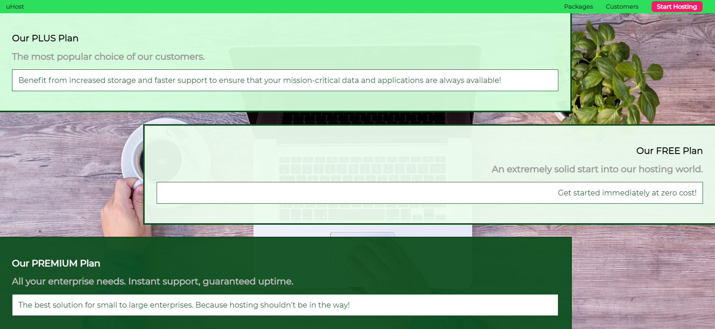
Positioning
Add a Background Image Using Position Property : Z - index
.background {
background: url("../images/plans-background.jpg");
width: 100%;
height: 100%;
position: fixed;
z-index: -1;
}

Slide 28
Positioning
Create a RECOMMENDED badge for first plan.
Add new h1 element with class = package__badge
Set the position: fixed in CSS file. (RECOMMENDED text will be taken out from document flow).
Try to position the RECOMMENDED text on right side top of out plan.

Slide 29

Positioning
Our text position is fix and it is related to viewport which is a problem to design.
Try other value of position property to get closer or easy solution
.package__badge{
position: fixed;
top: 50px;
right: 300px;
}

Slide 30
Positioning
Replace the fixed position with absolute.
Element is no longer fix to viewport but it is fix to the element.
.package__badge{
position: absolute;
top: 50px;
right: 300px;
}

Slide 31
Positioning
Positioning context is based on two cases.
If none of the ancestors , so of the parent elements , has a position property applied then the positioning context of the element is simply HTML element.
If we have any position ancestors, then the closest ancestor which has the positioning property applied is the positioning context for this element.

Slide 32
Positioning
In our case the positioning context is html.
Change the positioning context by adding position = absolute | relative property to the package class.
Decorate the RECOMMENDED text to be appear like badge

Slide 33
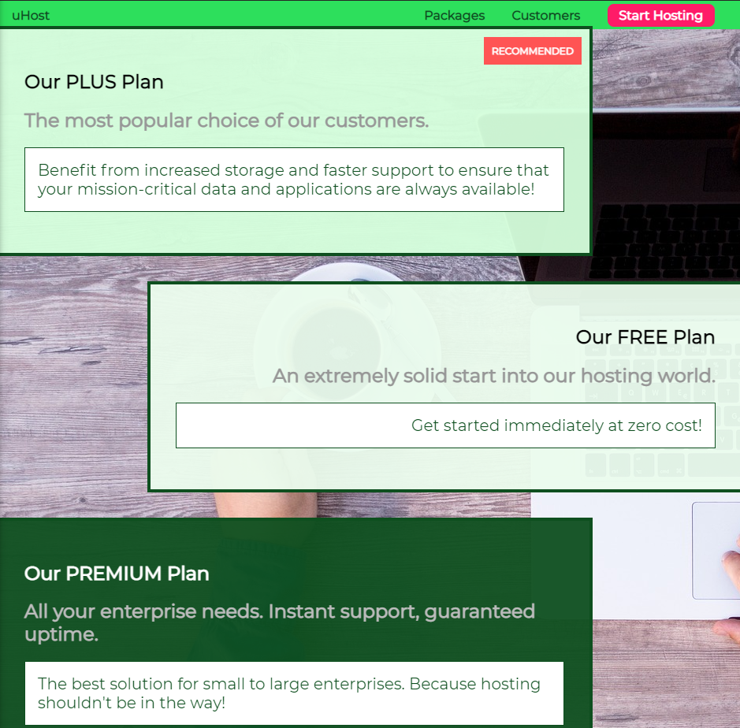
Positioning
.package__badge{
/* position: fixed; */
position: absolute;
top: 0px;
right: 0px;
margin: 10px;
font-size: 12px;
color: white;
background: #ff5454;
padding: 10px;
}

Slide 34
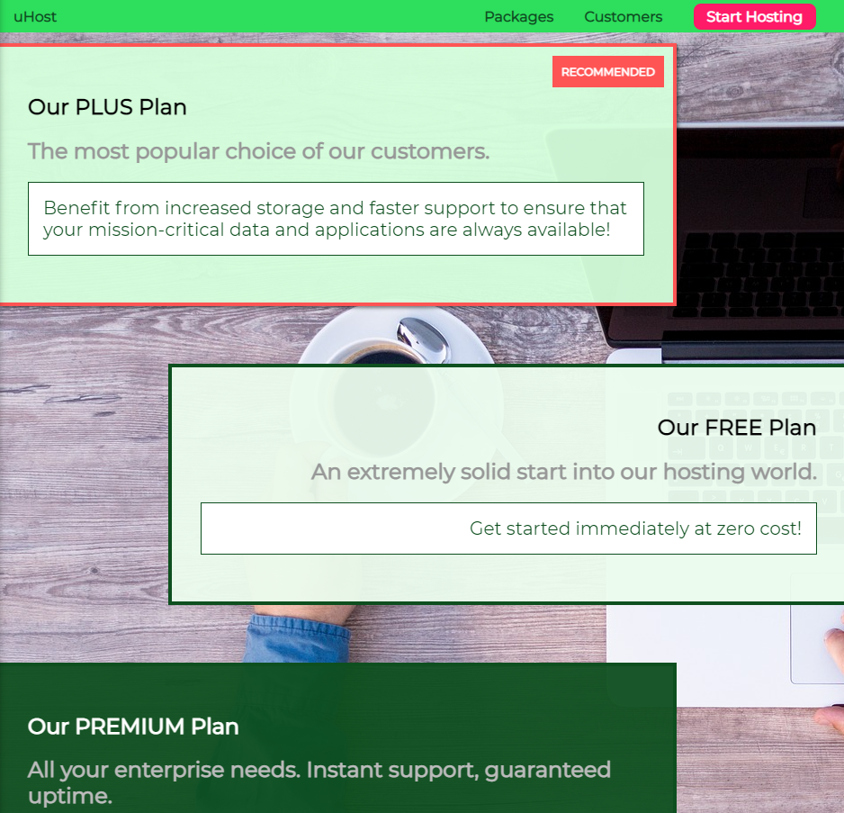
Positioning
If we scroll down , our packages are going above our navigation(menu).
Some part of first package is behind the navigation(menu).
.main-header {
width: 100%;
background: #2ddf5c;
padding: 8px 16px;
position: fixed;
z-index: 1;
}
.package{
border: 4px solid #0e4f1f;
margin: 32px 0px;
width: 80%;
border-left: none;
position: relative;
}

Slide 35
Understanding Relative Positioning
Import the source code to understand the relative position.(Same code which we have for fix positioning)

Slide 36
Understanding Relative Positioning
Add the relative position to our class = child-1
Nothing changes, elements stays or behaves the same way it was.
Add top and left flow to the child-1
The elements are not taken out of the document flow.
In case of relative positioning the positioning context is the element itself.

Slide 37
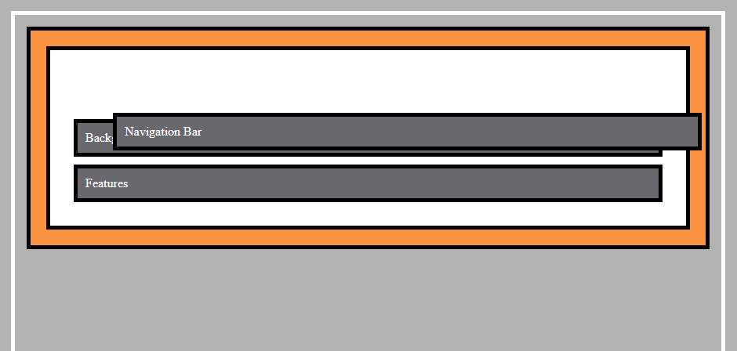
Understanding Relative Positioning
.parent .child-1 {
position: relative;
top: 50px;
left: 50px;
}

Slide 38
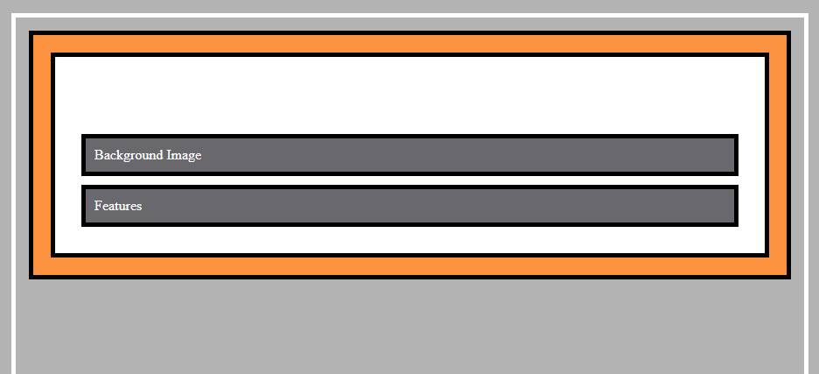
Understanding Relative Positioning
Hide the element if it leaves the parent container.
.parent .child-1 {
position: relative;
top: 300px;
left: 50px;
}
.parent {
background: white;
padding: 20px;
border: 5px solid black;
margin: 0;
overflow: hidden;
}

Slide 39
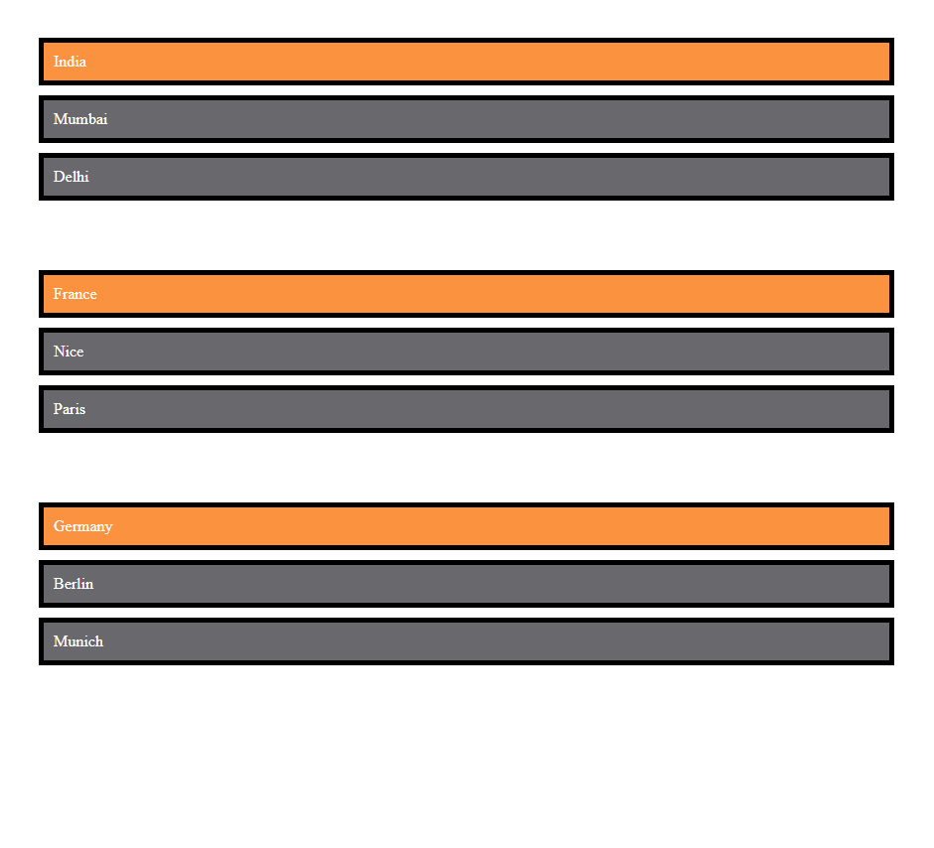
Understanding Sticky Positioning
Sticky is a hybrid or a combination of relative and fixed.
Import the source code to understand the sticky positioning.

Slide 40
Understanding Sticky Positioning
Scroll up and down to understand the behavior of sticky positioning.
.parent .country {
background: #fa923f;
color: white;
padding: 10px;
border: 5px solid black;
margin: 10px;
position: sticky;
top: 0px;
}

Slide 41
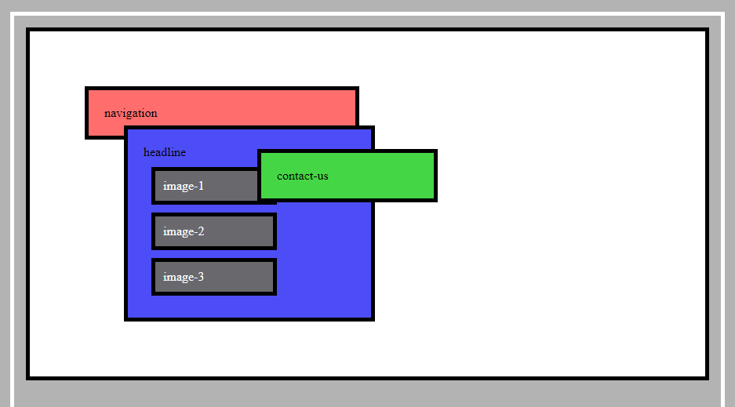
Understanding the Stacking Context
Import the source code to understand the stacking context.
Add position = fixed property to the navigation , headline and contact-us class.
.navigation, .headline, .contact-us {
padding: 20px;
border: 5px solid black;
margin: 10px;
position: fixed;
}

Slide 42
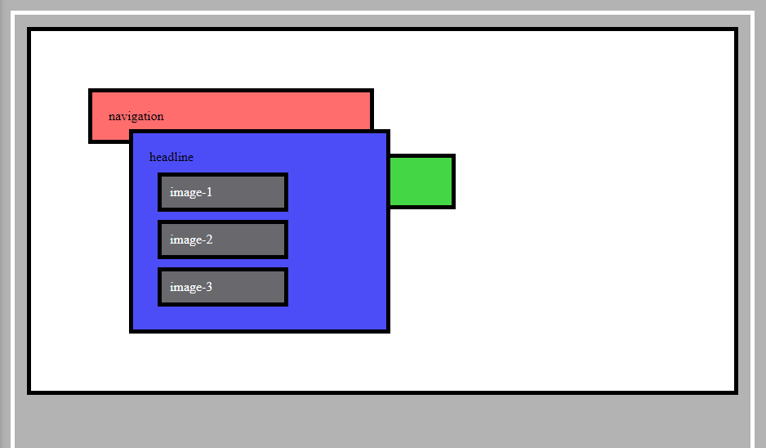
Understanding the Stacking Context
Add z-index = 1 for the headline to display headline on top of all elements
.headline {
background: rgb(77, 77, 248);
top: 150px;
left: 150px;
width: 270px;
height: 200px;
z-index: 1;
}

Slide 43
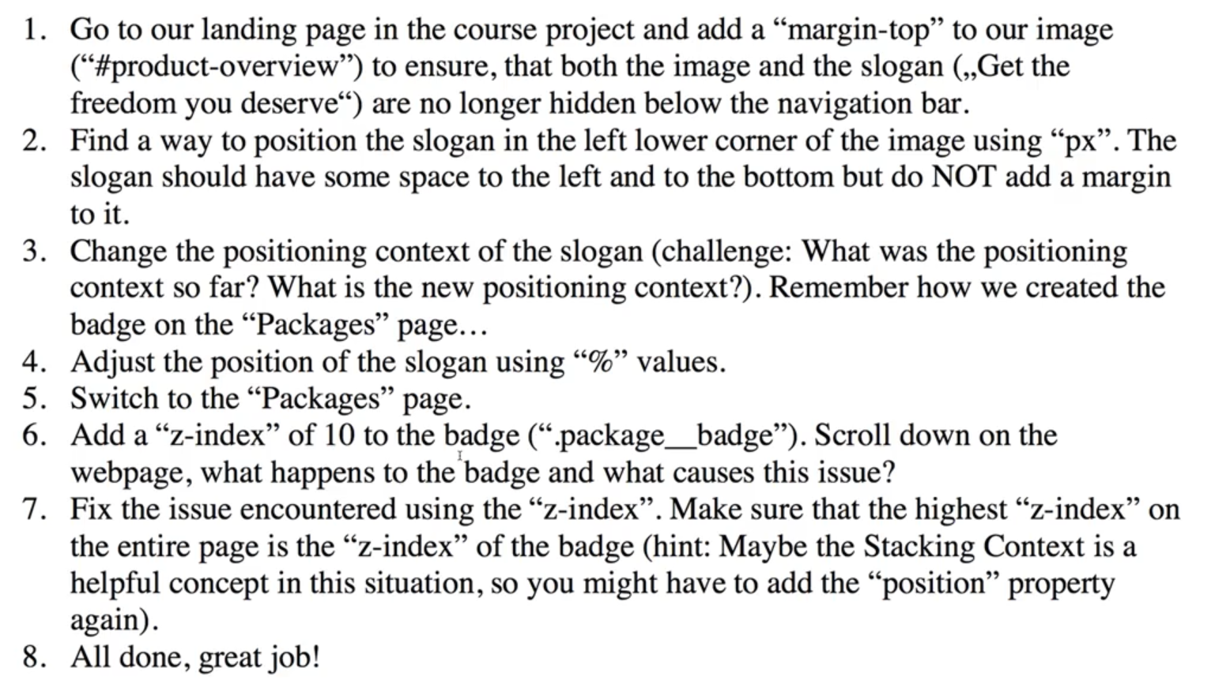
Positioning : Task

Slide 44
Positioning : Solution
1.
#product-overview h1 {
color: white;
font-family: 'Anton', sans-serif;
margin-top: 45px;
}
2.
#product-overview h1 {
color: white;
font-family: 'Anton', sans-serif;
margin-top: 45px;
position: absolute;
top: 400px;
}
3.
#product-overview {
/* background: #ff1b68; */
background: url("freedom.jpg");
width: 100%;
height: 500px;
padding: 10px;
position: relative;
}
#product-overview h1 {
color: white;
font-family: 'Anton', sans-serif;
margin-top: 45px;
position: absolute;
bottom: 0px;
left: 20px;
}
4.
#product-overview h1 {
color: white;
font-family: 'Anton', sans-serif;
margin-top: 45px;
position: absolute;
bottom: 1%;
left: 2%;
}
6.
.package__badge{
/* position: fixed; */
position: absolute;
top: 0px;
right: 0px;
margin: 10px;
font-size: 12px;
color: white;
background: #ff5454;
padding: 10px;
z-index: 10;
}
7.
.package{
border: 4px solid #0e4f1f;
margin: 32px 0px;
width: 80%;
border-left: none;
position: relative;
z-index: 0;
}

Slide 45
Backgrounds & Images
Because a Picture Says More Than A Thousand Words

Slide 46
Content
Understanding the background property
How to style Images and Background Images
Gradients
Filters

Slide 47
Understanding the background-size
Position and size the image properly on our home page
Use background-image property
Use background-size propertry
Set in widthpixels
Cover
contrain
User background-repeat: no-reapeat
The case where we had a width of 100% and height of auto or undefined , that the image takes the full width of the container it dose not overlap to the left or right but it also dose not overlap to the top and bottom.

Slide 48

Understanding the background-size
#product-overview {
/* background: #ff1b68; */
/* background: url("freedom.jpg"); */
background-image: url("freedom.jpg");
background-size: cover;
background-repeat: no-repeat;
width: 100%;
height: 500px;
padding: 10px;
position: relative;
}

Slide 49
Understanding the background-position
Value | Description
left top left center left bottom right top right center right bottom center top center center center bottom | If you only specify one keyword, the other value will be "center"
x% y% | The first value is the horizontal position and the second value is the vertical. The top left corner is 0% 0%. The right bottom corner is 100% 100%. If you only specify one value, the other value will be 50%. . Default value is: 0% 0%
xpos ypos | The first value is the horizontal position and the second value is the vertical. The top left corner is 0 0. Units can be pixels (0px 0px) or any other CSS units. If you only specify one value, the other value will be 50%. You can mix % and positions
initial | Sets this property to its default value.
inherit | Inherits this property from its parent element.

Slide 50

Understanding the background-position
#product-overview {
/* background: #ff1b68; */
/* background: url("freedom.jpg"); */
background-image: url("freedom.jpg");
background-size: cover;
background-position: left 10% bottom 40%;
background-repeat: no-repeat;
width: 100%;
height: 500px;
padding: 10px;
position: relative;
}

Slide 51
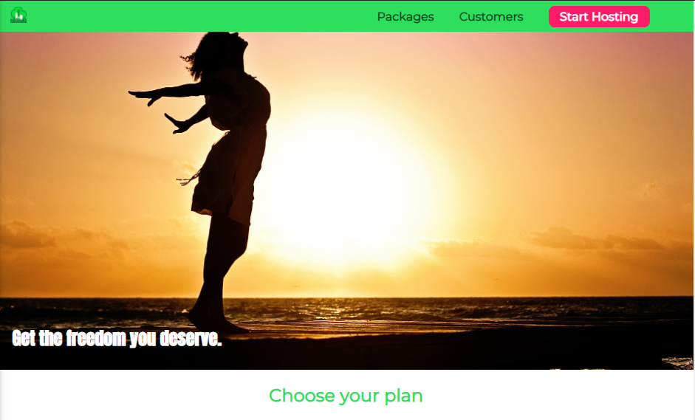
Styling Images
Add website logo – replace uHost text with logo.
add image into header
<a class="main-header__title" href="index.html">
<img src="images/uhost-icon.png" alt="uHost - Your favorite hosting company">
</a>
.main-header__brand {
color: #0e4f1f;
text-decoration: none;
/* font-weight: bold; */
display: inline-block;
height: 22px;
}
.main-header__brand img {
height: 100%;
/* height: 20px; */
}

Slide 52
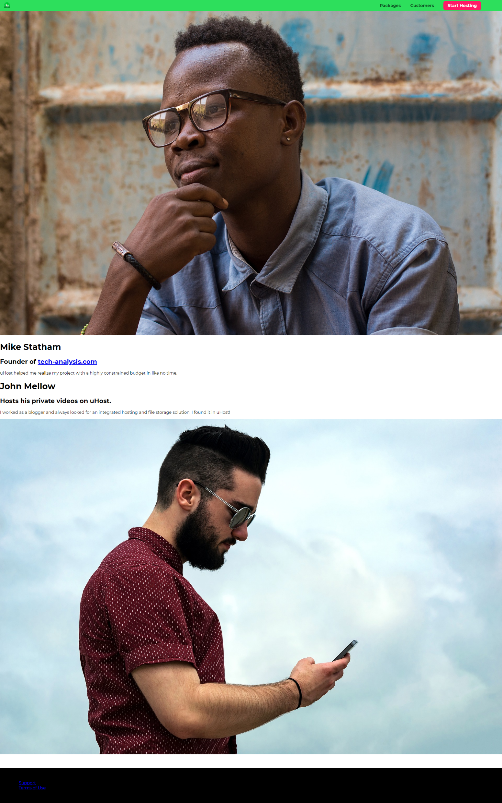
Add Customers Page
Import the shared code in our website and link to the customers menu.

Slide 53
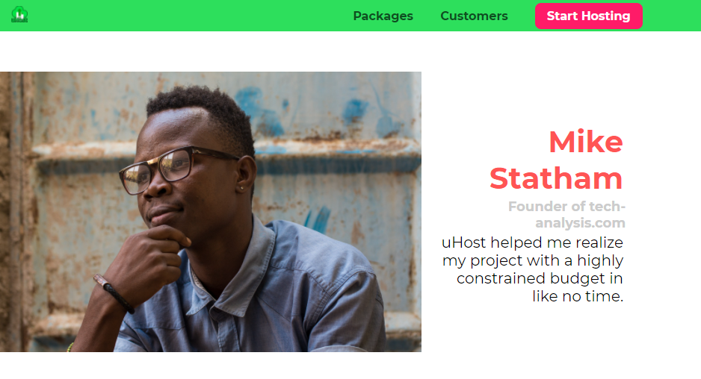
Working On Image Layout
Display the customer image and description side by side.

Slide 54
Working On Image Layout
.testimonial__image-container {
width: 60%;
display: inline-block;
vertical-align: middle;
}
.testimonial__image{
width: 100%;
}
.testimonial__info {
text-align: right;
padding: 14px;
display: inline-block;
vertical-align: middle;
width: 30%;
}

Slide 55
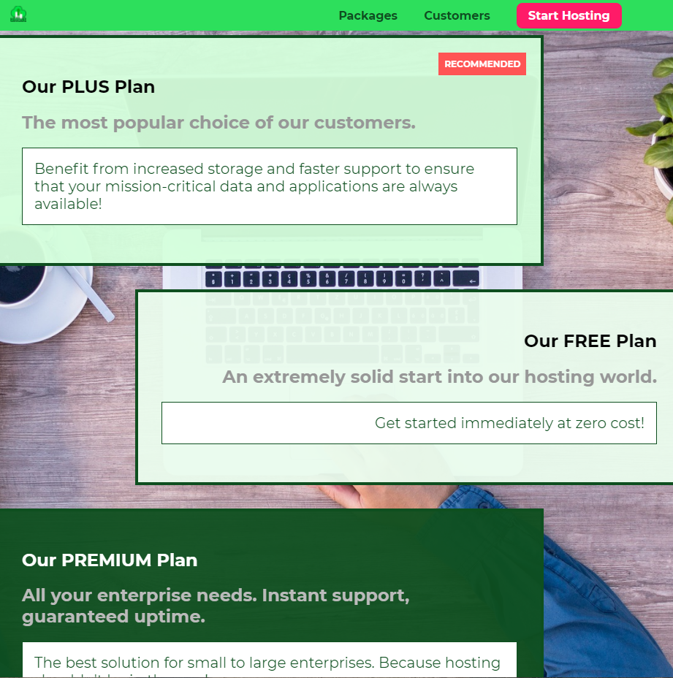
Working On Image Layout
Set the position of background image for packages page.
background: url("../images/plans-background.jpg") center/cover;

Slide 56
Understanding Sizes & Units
What’s wrong with our project units ?
If we zoom our website it will increase the font size.
Because of this behaviour we totally give the browser the chance to decide how our side should be zoomed.
Increase the font size of browser from browser settings to MAX
It is not good , we want to make sure that the general look so that proportion between the different font size are still met.
Using a fixed font size in px and letting the browser do the work is not a good practice.

Slide 57
Pixels, Percentages & More
Units
Which properties can I use in connection with these units?
pixels
px
How is the size calculated?
percentages
%
What’s the right unit to choose?
root em
rem
em
em
viewport hight
vh
Viewport width
vw

Slide 58
Understanding the working of %
How dose the % using work
3 Rules to remember to understand
Whenever we have an element which has the position fixed declaration applied and a percentage unit, then the containing block is the viewport.
Example : Menu of our site
Whenever we have an element which has the position absolute declaration applied and a percentage unit, then the containing block is ancestor(content + padding) with either absolute , relative ,fixed, sticky position property.
Example : Frontpage image and text
Whenever we have an element which has the position static or relative applied and a percentage unit , then the containing block is ancestor (only content) , ancestor have to be a block level element.
Example : Customer page , image container

Slide 59
Understanding the working of %
Add a new element called backdrop.
Create a new element which has a width of 100% and height of 100

Slide 60
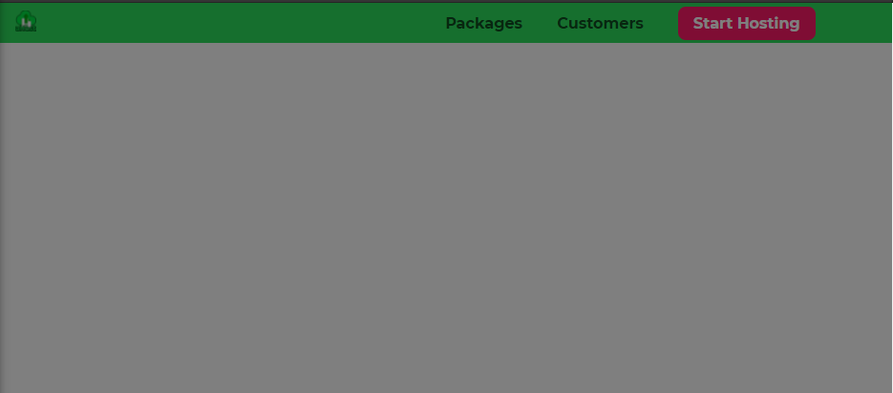
Understanding the working of %
Add new div in body with class=backdrop in all index.html files
<div class="backdrop"></div>
.backdrop{
position: relative;
z-index: 100;
width: 100%;
height: 100%;
background: rgba(0,0,0,0.5);
}
body {
font-family: 'Montserrat', sans-serif;
margin: 0;
height: 100%;
}
html{
height: 100%;
}

Slide 61
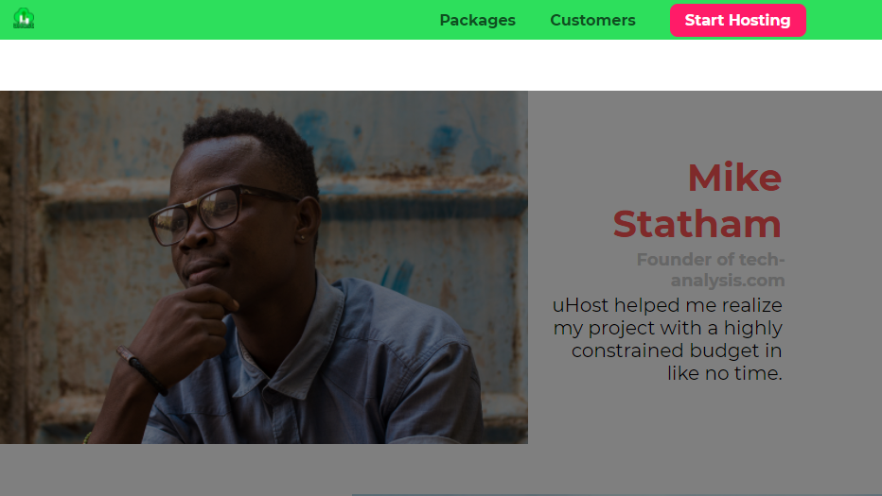
Understanding the working of %
Change the position value from relative to absolute
Remove hight : 100% from body and html
.backdrop{
position: absolute;
z-index: 100;
width: 100%;
height: 100%;
background: rgba(0,0,0,0.5);
}

Slide 62
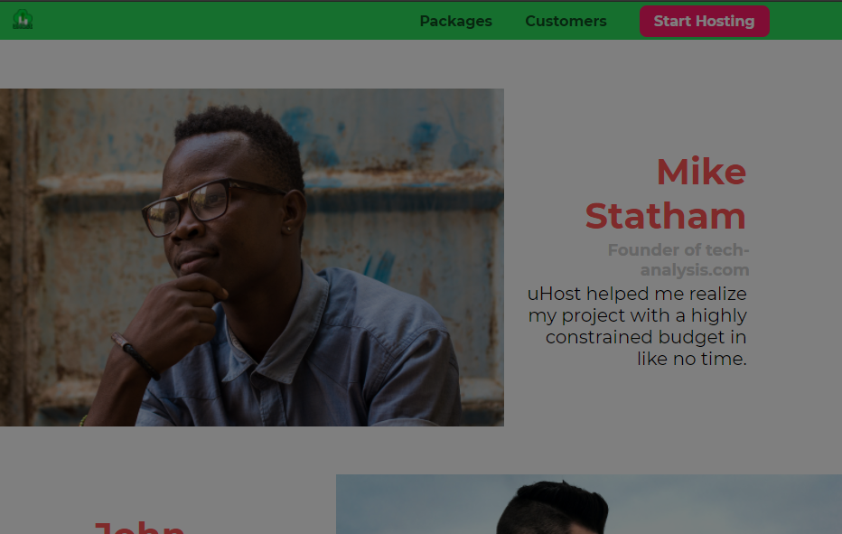
Understanding the working of %
Change the position value from absolute to fixed
.backdrop{
position: fixed;
z-index: 100;
width: 100%;
height: 100%;
background: rgba(0,0,0,0.5);
top: 0;
left: 0;
}
.backdrop{
position: fixed;
z-index: 100;
width: 100%;
height: 100%;
background: rgba(0,0,0,0.5);
top: 0;
left: 0;
display: none;
}

Slide 63
Working with rem
Our web page font dose not change when we change the font size in browser.
If you want to provide this facility to use implement rem(root element) font size.

Slide 64
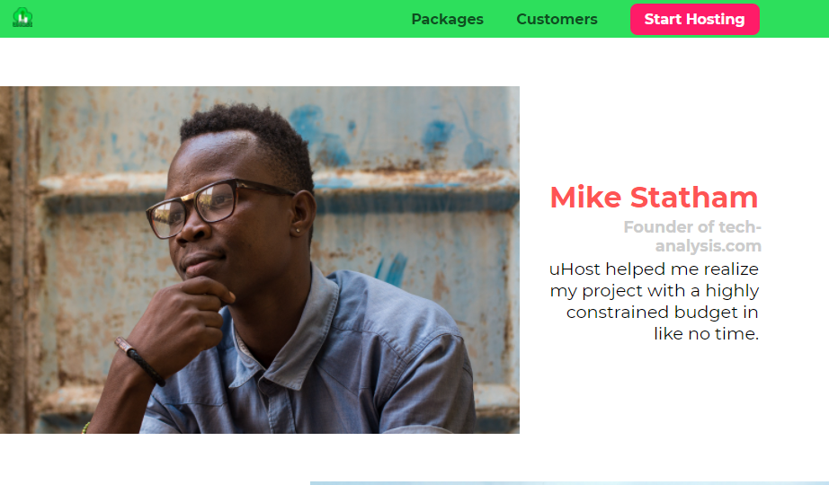
Working with rem
.testimonial {
font-size: 1.2rem;
margin: 48px 0;
}
.testimonial__name {
margin: 3px;
color: #ff5454;
font-size: 2rem;
}
.testimonial__subtitle {
margin: 0;
font-size: 1.1rem;
color: #ccc;
}

Slide 65
Working with rem : Task
Apply the rem unit on margin and padding to all css files.

Slide 66
Understanding The Viewport vw and vh
Apply vw and vh units on our backdrop by removing display: none.
Apply vw and vh units on our background image of packages page
.backdrop {
position: fixed;
/* display: none; */
top: 0;
left: 0;
z-index: 100;
/* width: 100%; */
/* height: 100%; */
width: 100vw;
height: 100vh;
background: rgba(0,0,0,0.5);
}
.background {
background: url("../images/plans-background.jpg") center/cover;
filter: grayscale(40%);
width: 100vw;
height: 100vh;
position: fixed;
z-index: -1;
}

Slide 67
CSS and JavaScript
Sometimes, content needs to change after the page was loaded

Slide 68
Content
Manipulating Styles via JavaScript
Adding & Removing CSS Classes using JavaScript

Slide 69
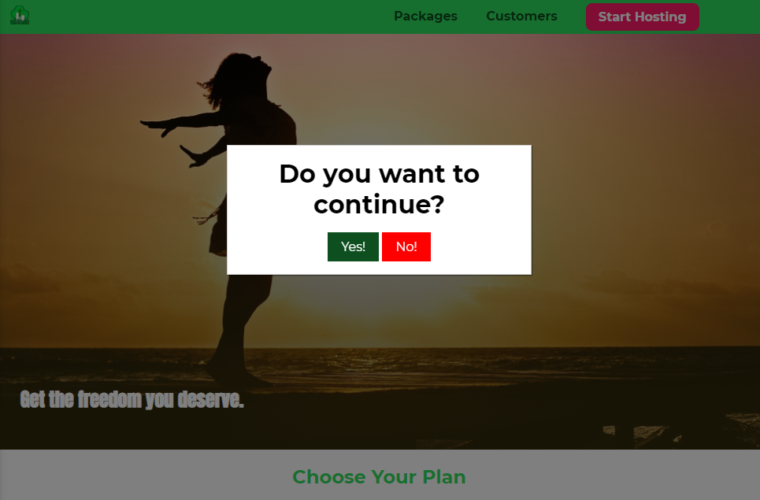
Adding a Modal HTM & CSS Code
Import the modal html and CSS code , import in home page(index.html) after backdrop div and main.css(at the end) file.

Slide 70
Selecting & Manipulating Style with JavaScript
Create new JavaScript file as shared.js and import script tag in index.html
var backdrop = document.querySelector('.backdrop');
var modal = document.querySelector('.modal')
var modalNoButton = document.querySelector('.modal__action--negative');
var selectPlanButtons = document.querySelectorAll('.plan button');
for(var i=0;i<selectPlanButtons.length;i++){
selectPlanButtons[i].addEventListener('click',function() {
modal.style.display = 'block';
backdrop.style.display = 'block';
});
} backdrop.addEventListener('click', closeModal);
modalNoButton.addEventListener('click', closeModal); function closeModal(){
backdrop.style.display = 'none';
modal.style.display = 'none';
}

Slide 71
Add a Side Navigation Bar
Add Shared HTML code in index.html file (between end of header and start of main tag)
</header>
<nav class="mobile-nav">
<ul class="mobile-nav__items">
<li class="mobile-nav__item">
<a href="packages/index.html">Packages</a>
</li>
<li class="mobile-nav__item">
<a href="customers/index.html">Customers</a>
</li>
<li class="mobile-nav__item mobile-nav__item--cta">
<a href="start-hosting/index.html">Start Hosting</a>
</li>
</ul>
</nav>
<main>

Slide 72
Add a Side Navigation Bar
Add Shared CSS Code in shared.css file(before buttons class declaration).
.mobile-nav {
display: none;
position: fixed;
z-index: 101;
top: 0;
left: 0;
background: white;
width: 80%;
height: 100vh;
}
.mobile-nav__items {
width: 90%;
height: 100%;
list-style: none;
margin: 10% auto;
padding: 0;
text-align: center;
}
.mobile-nav__item {
margin: 1rem 0;
}
.mobile-nav__item a {
font-size: 1.5rem;
}

Slide 73
Add a Side Navigation Bar
Set modal display : none and backdrop display: none
Additional change below CSS property of shared.css file.
.main-nav__item a,
.mobile-nav__item a{
text-decoration: none;
color: #0e4f1f;
font-weight: bold;
padding: 0.2rem 0;
}
.main-nav__item--cta a:hover,
.main-nav__item--cta a:active,
.mobile-nave__item--cta a:hover,
.mobile-nave__item--cta a:active
{
color: #ff1b68;
background: white;
border: none;
}
.main-nav__item--cta a,
.mobile-nav__item--cta a
{
color: white;
background: #ff1b68;
padding: 0.5rem 1rem;
border-radius: 8px;
}

Slide 74
Add a Side Navigation Bar
Set mobile-nav display:none
Add button code in index.html file.
<div>
<button class="toggle-button">
<span class="toggle-button__bar"></span>
<span class="toggle-button__bar"></span>
<span class="toggle-button__bar"></span>
</button>
<a href="index.html" class="main-header__brand">
<img src="images/uhost-icon.png" alt="uHost - Your favorite hosting company">
</a>
</div>

Slide 75
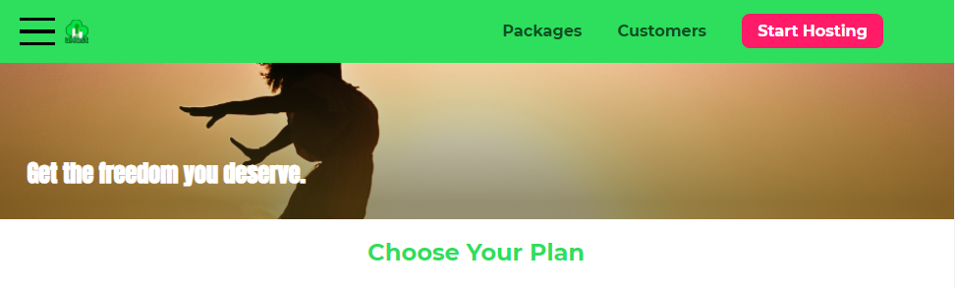
Add a Side Navigation Bar
Add CSS design code in shared.css file above main-header_brand
.toggle-button {
width: 3rem;
background: transparent;
border: none;
cursor: pointer;
padding-top: 0;
padding-bottom: 0;
vertical-align: middle;
} .toggle-button:focus {
outline: none;
} .toggle-button__bar {
width: 100%;
height: 0.2rem;
background: black;
display: block;
margin: 0.6rem 0;
}
.main-header__brand {
color: #0e4f1f;
text-decoration: none;
font-weight: bold;
font-size: 1.5rem;
height: 1.5rem;
/* width: 20px; */
display: inline-block;
vertical-align: middle;
}
.main-nav {
display: inline-block;
text-align: right;
width: calc(100% - 120px);
vertical-align: middle;
}

Slide 76
Add a Side Navigation Bar
Open and close the side menu on button click a
var backdrop = document.querySelector(".backdrop");
var modal = document.querySelector(".modal");
var modalNoButton = document.querySelector(".modal__action--negative");
var selectPlanButtons = document.querySelectorAll(".plan button");
var toggleButton = document.querySelector('.toggle-button');
var mobileNav = document.querySelector('.mobile-nav');
// console.dir(backdrop);
for (var i = 0; i < selectPlanButtons.length; i++) {
selectPlanButtons[i].addEventListener("click", function() {
modal.style.display = "block";
backdrop.style.display = "block";
});
}

Slide 77
Add a Side Navigation Bar
backdrop.addEventListener("click", function() {
mobileNav.style.display = 'none';
closeModal();
});
modalNoButton.addEventListener("click", closeModal);
function closeModal() {
backdrop.style.display = "none";
modal.style.display = "none";
}
toggleButton.addEventListener('click', function() {
mobileNav.style.display = 'block';
backdrop.style.display = 'block';
});

Slide 78
Add a Side Navigation Bar
Add side navigation bar and hamburger menu to packages.html and customers.html pages.
Don’t forget to add script tag at the end of each file.

Slide 79
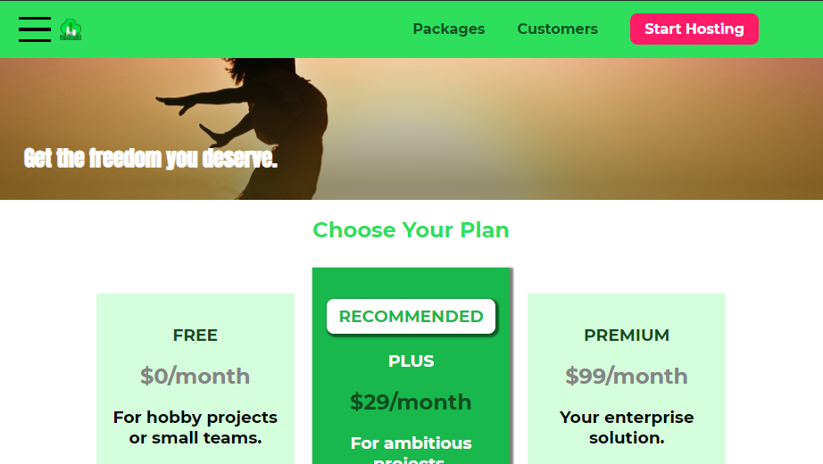
Add a Side Navigation Bar
Import the updated JavaScript code.

Slide 80
Responsive Design
Let’s make our page look awesome on all devices

Slide 81
Content
Difference between Hardware vs Software Pixels
Viewport <meta> tag in HTML
Media Queries with @media

Slide 82
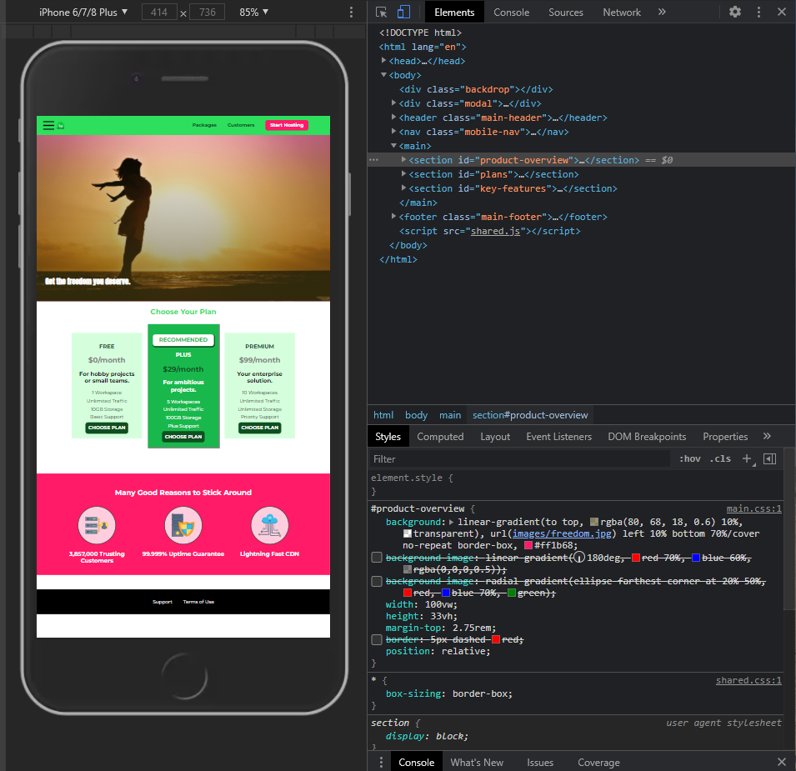
Understanding Hardware Pixels vs Software Pixels
Browser dose not understand the difference between desktop device and mobile device.
open website in mobile simulator of development tools of chrome.

Slide 83
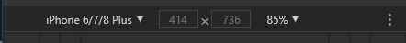
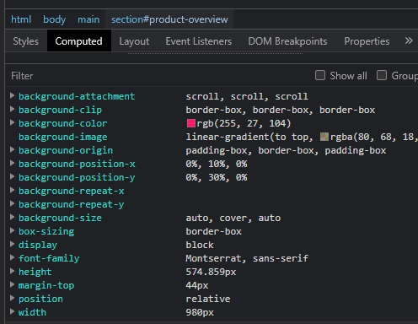
Understanding Hardware Pixels vs Software Pixels
Compare the width currently applied on UI and actual width set.

Slide 84
Understanding Hardware Pixels vs Software Pixels
Currently for mobile phone website looks really too small.
It is because of the modern mobiles phones have really high pixel.
Traditional way of calculating pixels is not working with mobile.

Slide 85
Understanding Hardware Pixels vs Software Pixels
Understanding actual calculation of pixel conversion in mobile devices.
Open https://www.mydevice.io/#compare-devices

Slide 86
Understanding Hardware Pixels vs Software Pixels
Add meta tag in head section of all html pages.
<head>
<meta charset="UTF-8">
<meta http-equiv="X-UA-Compatible" content="ie=edge">
<meta name="viewport" content="width=device-width, initial-scale=1.0">
<title>uHost</title>
<link rel="shortcut icon" href="favicon.png">
<link href="https://fonts.googleapis.com/css?family=Anton" rel="stylesheet">
<link href="https://fonts.googleapis.com/css?family=Montserrat:400,700" rel="stylesheet">
<link rel="stylesheet" href="shared.css">
<link rel="stylesheet" href="main.css">
</head>

Slide 87

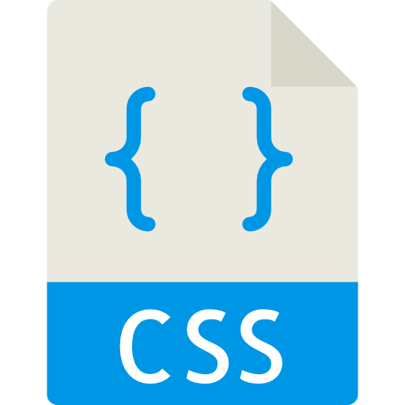
Which Tools Do We Have ?
Viewport
Media Queries
Adjust site to device viewport
Change design depending on size
No design changes
Design changes defined by us

Slide 88
Understanding Viewport Metatag
It should target the viewport – current display
Zoom scale = 1 = (100% default)
<meta name="viewport" content="width=device-width, initial-scale=1.0">
depending on device width - It should apply the pixel ratio

Slide 89

Adding Our First Media Queries
Lets increase the font size of text of home screen when we increase the screen width greater than 640px.
Add media query below #product-overview h1
#product-overview h1 {
color: white;
font-family: "Anton", sans-serif;
position: absolute;
bottom: 5%;
left: 3%;
font-size: 1.6rem;
}
@media (min-width: 40rem) {
#product-overview h1 {
font-size: 3rem;
}
}

Slide 90
Creating the mobile First Design for our Plans
Display the plans below each other of device width is less than 640 pixels.
Remove the display : inline-block from plan class
Set the width to 100% by removing width:30% to the plan class.
Remove the margin from .plan_list and set width to 100%
Remove the left and right margin from plan class.
We do not require the vertical-align: middle.
We do not require the class plan_list
Remove the box-shadow from recommended plan

Slide 91
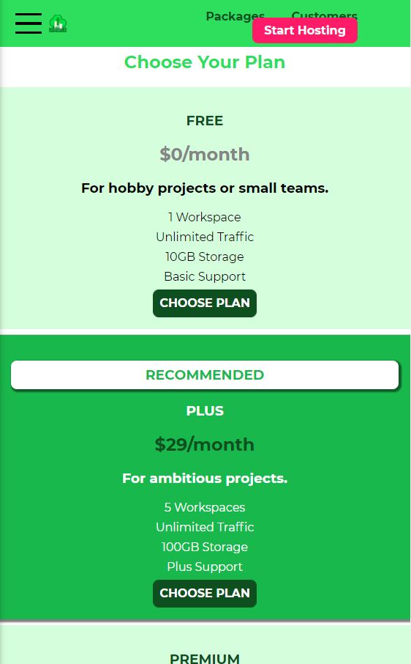
Creating the mobile First Design for our Plans
/* .plan__list {
/* width: 80%;
margin: auto;
width: 100%;
text-align: center;
} */
.plan {
background: #d5ffdc;
text-align: center;
padding: 1rem;
margin: 0.5rem 0;
/* display: block; */
/* width: 30%; */
width: 100%;
/* vertical-align: middle; */
}
.plan--highlighted {
background: #19b84c;
color: white;
/* box- shadow: 2px 2px 2px 2px rgba(0, 0, 0, 0.5); */
}

Slide 92

Creating the Desktop VersionDesign for our Plans – Using @Media
Add media query below the .plan_feature class
@media (min-width: 40rem){
.plan__list {
width: 100%;
margin: auto;
text-align: center;
}
.plan{
width: 30%;
display: inline-block;
vertical-align: middle;
min-width: 13rem;
max-width: 25rem;
}
.plan--highlighted {
box-shadow: 2px 2px 2px 2px rgba(0, 0, 0, 0.5);
}

Slide 93
Creating the mobile First Design for Many Good Reasons

